Slide 1
Loan Default Prediction

Slide 2
Presented By
Anas Alrantisi
Ibrahim Abedalghafer
Mohammad Awad

Slide 3
Agenda
Introduction to the problem
Define The dataset
Tools Used
Airflow DAGs
Model Results
Data visualization & insights

Slide 4
The problem
Loans are one of the main streams of revenue for bank.
Trying to Predict the borrowers that will most likely default ahead of time is of great importance to enable decision makers to deal with the situation accordingly.
This is a classification problem of imbalanced data in which we need to classify whether the borrower will default or not.

Slide 5
Dataset
Data set Consisting of 81692 rows that represent customers who have borrowed from the bank.
Data set have 56 features for various aspects such as (Gender, age, nationality, Marital status employment status, employer category, occupation, Customer deposits, Income
Salary transfer., Interest Rate…).

Slide 6
Dataset
Data set Consisting of 81692 rows that represent customers who have borrowed from the bank.
Data set have 56 features for various aspects such as (Gender, age, nationality, Marital status employment status, employer category, occupation, Customer deposits, Income
Salary transfer., Interest Rate…).

Slide 7
Data preprocessing
We dropped the rows that have missing values with less than 0.001 of the total amount of rows
We had 3 features (EmployerCategory, PaymentFrequency, EmploymentStatus) that have missing values more than .001 so we fill these missing values with mode as they are categorical data.
We had also 1 numerical feature (TotalCustomerDeposits) with missing values, and we used the mean to fill those missing values.

Slide 8
Data preprocessing
Added a new label column to indicate that the customer is in default or not based on NoDaysDelinquent column ( if >= 90) then there is a default in loan, this is determined based on the discussion with the business unit.
Some of the features were dropped based also on the discussion with the business unit like ‘customer ID’.
Then the correlation matrix was formed, and the highly correlated features ( >=0.8) were dropped

Slide 9
Data preprocessing
A manual(label encoding of 0 and 1) encoding was done for the features that had the binary values (like yes and no)
Apply One Hot Encoding for all other attributes

Slide 10
Data preprocessing
A manual(label encoding of 0 and 1) encoding was done for the features that had the binary values (like yes and no)
Apply One Hot Encoding for all other attributes

Slide 11
Data preprocessing
Normalize our numerical attributes (which are 3 attributes) using the MinMaxScaler function. As there is a difference between those values
The features that are normalized:
TotalCustomerDeposits: where min value is 0, and max value is 1145401.833
ApprovedAmountEQVL: where min value is -28609.003(negative means that they had a large amount of deposit) , and max value is 820000.0
TenorInMonths: where min value is 2, and max value is 371

Slide 12
Data preprocessing
As we are working on imbalanced data, one of the methods to be used to train the models when there an imbalanced data case is by balancing the training set
The SMOTE (Synthetic Minority Oversampling Technique) is used to balance the training set so that this set can be used to train the model, and then the test set of the original data is used for testing the model.

Slide 13
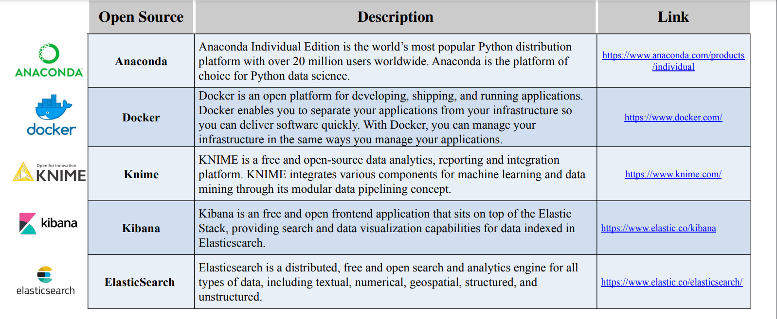
Tools used

Slide 14
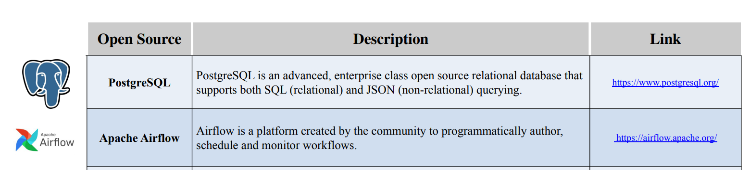
Tools used

Slide 15
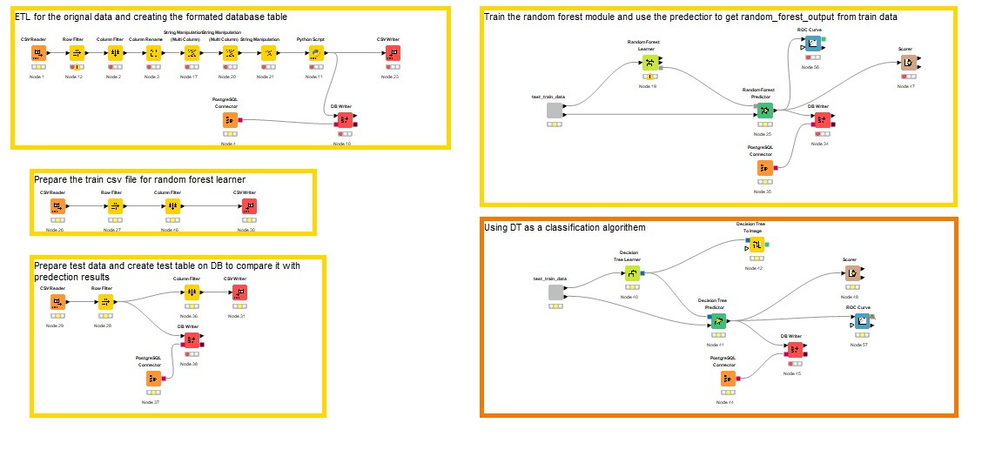
Knime

Slide 16
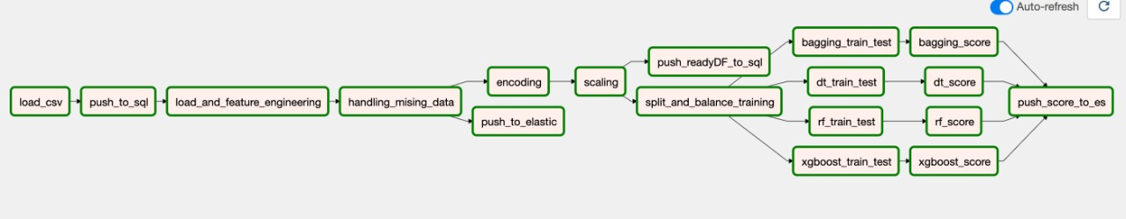
Airflow

Slide 17
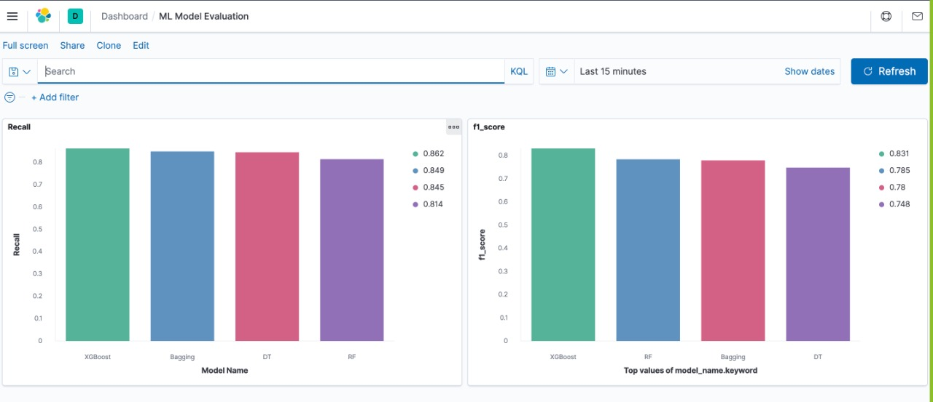
Model Result

Slide 18
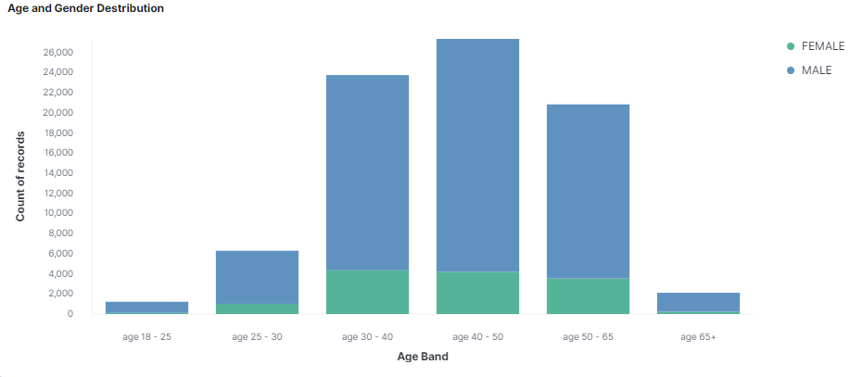
Data visualization

Slide 19
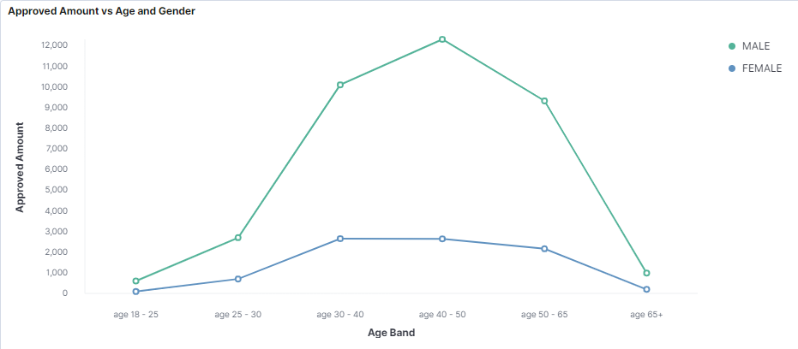
Data visualization

Slide 20
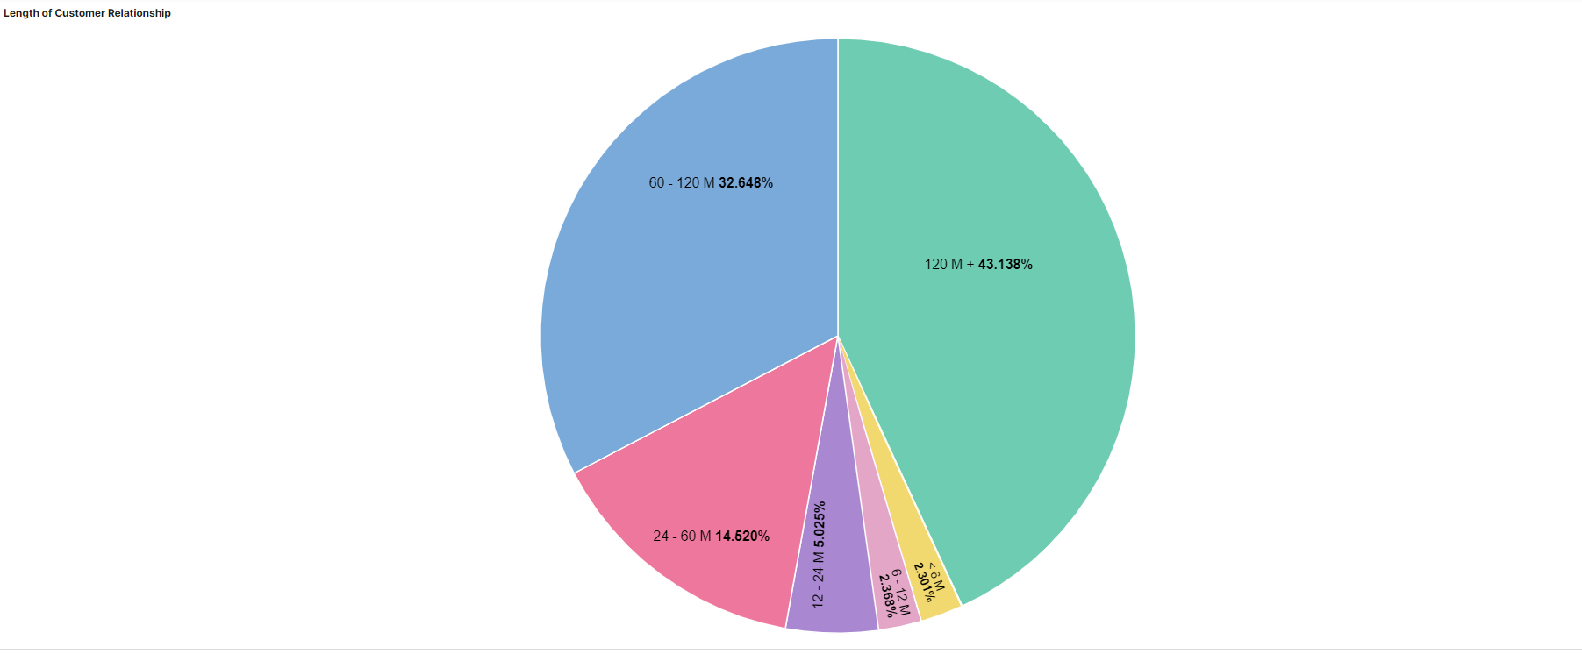
Data visualization

Slide 21
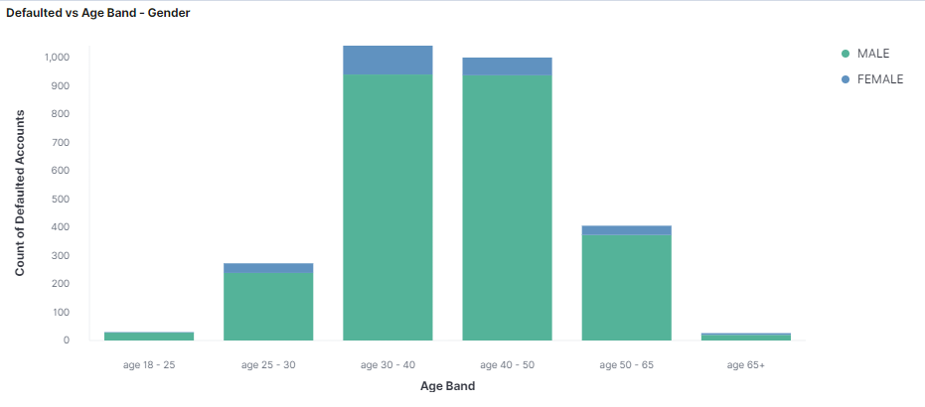
Data visualization

Slide 22
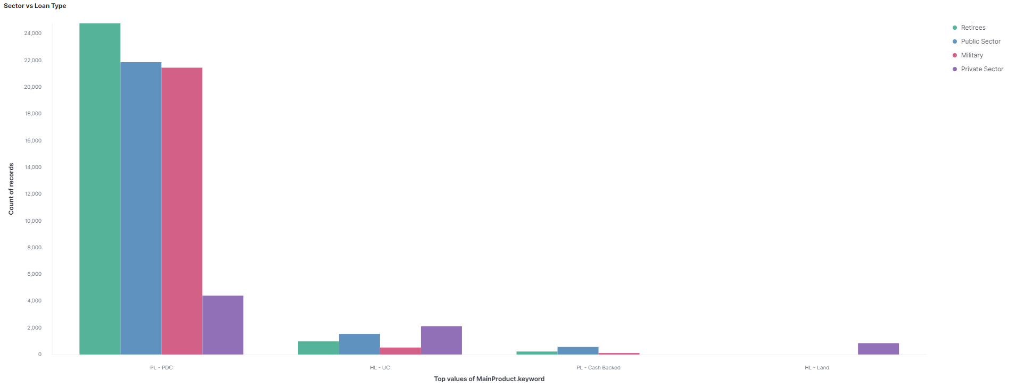
Data visualization

Slide 23
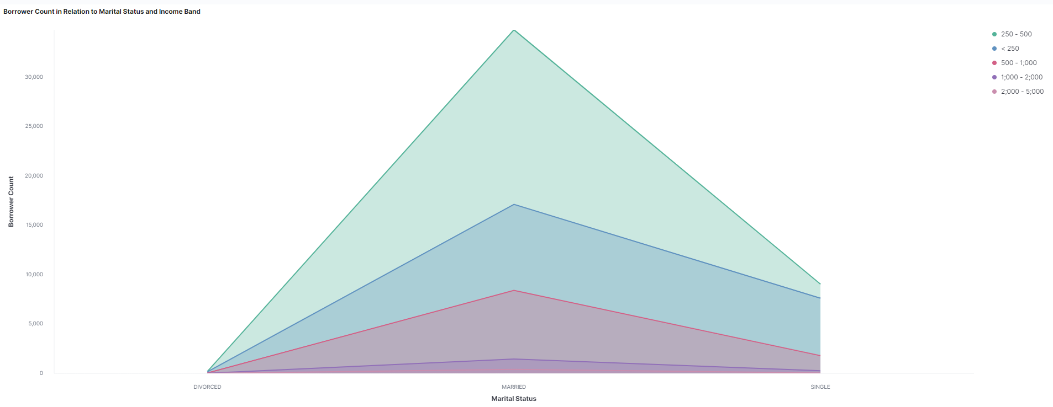
Data visualization

